Slide 1
RDBMS – SQL Activities

Slide 2
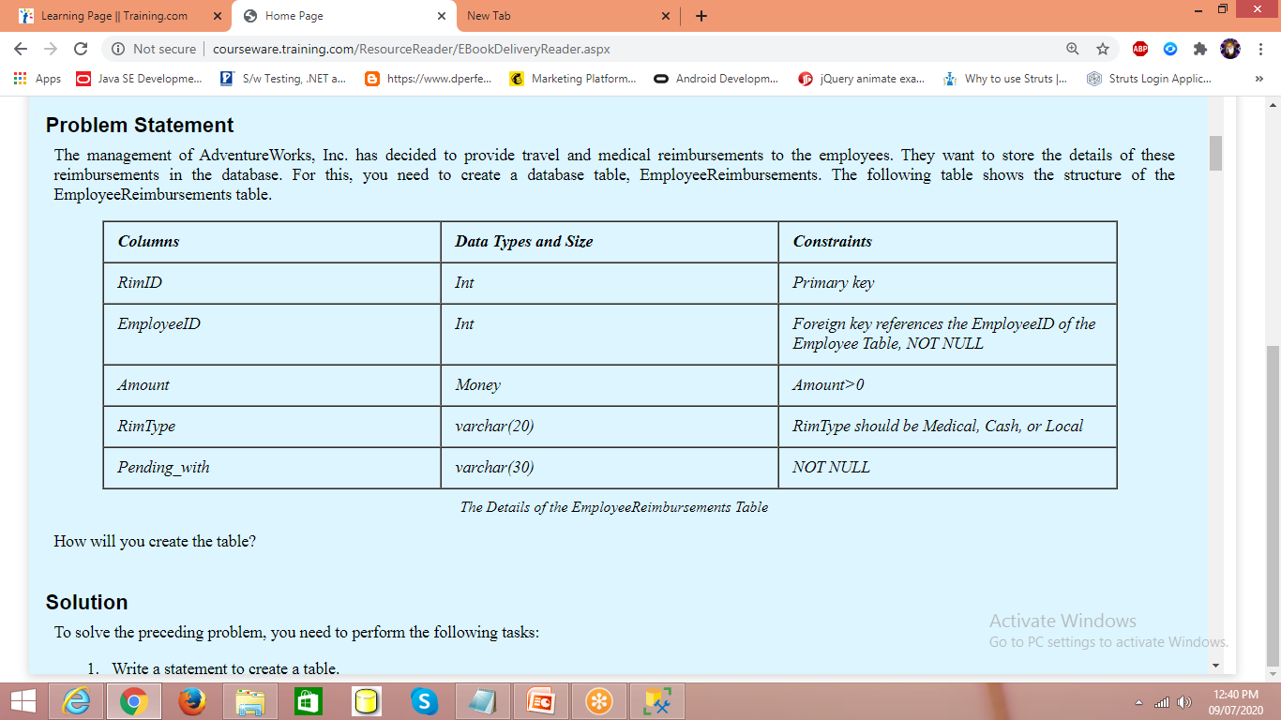
HumanResources.Employee
AdventureWorks2012 database – Employee table BusinessEntityID
AdventureWorks database – Employee table EmployeeID

Slide 3
----- We need to implement Auto-Generated values for column RimId
Property -- Identity(seed,increment) seed--- start value (1) increment -- step value(1)
By default -- Identityby default the seed and increment is 1
RimId to start from 10 with step value of 10 Identity(10,10)
Identity -- doesn't allow to insert manual values
if in case -- set Identity_insert tablename On
create table HumanResources.EmployeeReimbursements
(
RimId int Identity(1,1) not null constraint pkRid Primary key,
EmployeeId int not null constraint fkEid foreign key
references HumanResources.Employee(BusinessEntityID),
Amount money constraint chkAmt Check(Amount>0),
RimType varchar(20) constraint chktype Check(RimType in('Medical','Cash','Local')),
Pending_with varchar(30) not null
)
insert into HumanResources.EmployeeReimbursements (EmployeeId,Amount,
RimType,Pending_with) values
(21,3500,'Local','Shalakha')
select * from HumanResources.EmployeeReimbursements
delete from HumanResources.EmployeeReimbursements
where RimId=2
Set Identity_Insert HumanResources.EmployeeReimbursements ON
insert into HumanResources.EmployeeReimbursements (RimId,EmployeeId,Amount,
RimType,Pending_with) values
(2,29,500,'Local','Sarthak')

Slide 4
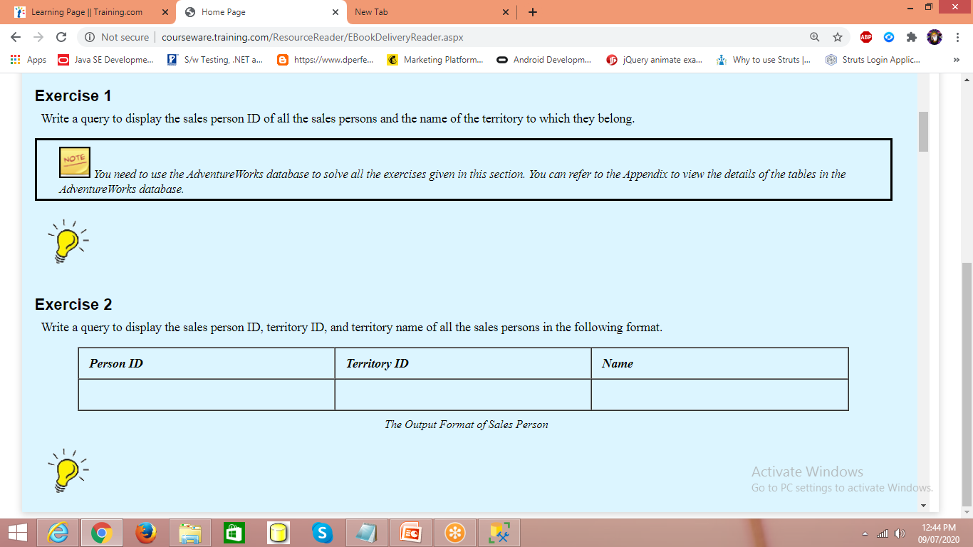

Slide 5
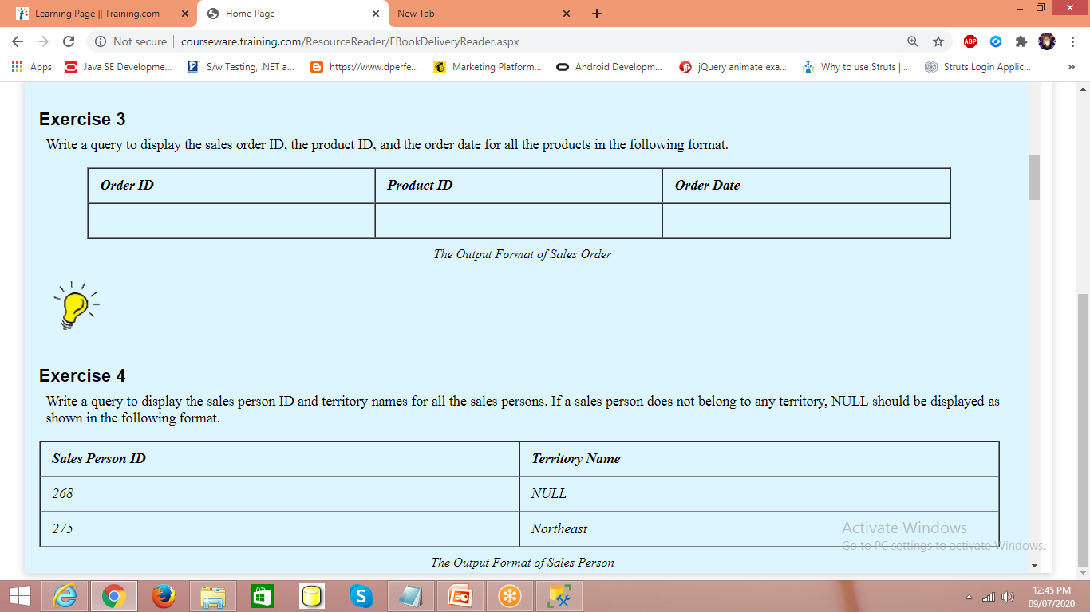

Slide 6
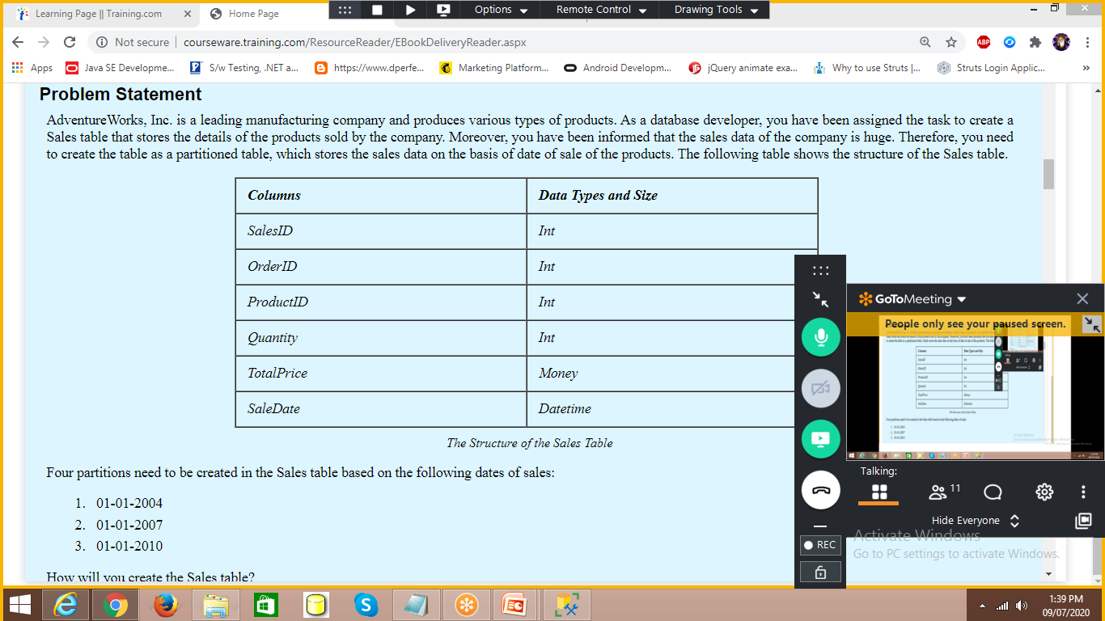

Slide 7
create partition function SalesData(Datetime)
as range right for values('2004-01-01','2007-01-01','2010-01-01')
-- filegroups group1,group2,group3,group4
-- files – ps1.ndf, ps2.ndf,…
create partition scheme SalesData
as partition SalesData
To (group1,group2,group3,group4)
Create table Sales
(
SalesId int,
OrderId int,
ProductId int,
Quantity int,
TotalPrice money,
SalesData datetime
)on SalesData(SalesData)

